Slide 1
PISA for Development
Out of School Technical Meeting
Notes:
Intro remarks
My colleagues and I are delighted and couldn’t be more thrilled to have this opportunity to present the PISA for development project to this meeting.
The cooperation that this represents between the OECD Directorates for Education and Skills and Development Cooperation and with our development partners and technical partners and with the countries represented in this meeting is very welcome
But for us as staff of OECD’s Education and Skills and Development Co-operation Directorates the PISA for development project is an exciting addition to our programme of work. And what we would like to do now is take you through the background to the project, the aims of the project and what it will seek to deliver over the coming three years.

Slide 2
PISA for Development How we arrived at this point – the journey
So far, PISA has covered 74 countries, 28 of which are developing countries (ODA recipients)
Our experience so far:
Relevance of the PISA approach and assessment
Adherence to technical standards
Quality of technical implementation matches that of OECD countries
Full compliance with confidentiality requirements
Some open issues
Match between student ability distribution and item difficulties
Relevance of context questionnaires
Out-of-school populations
How far can we go with expanding PISA as we know it?
Notes:
So, having set out our motivations, now, a bit of where we are coming from, the journey so far.
PISA began to be developed in 1998 with 28 OECD countries, but since then country participation has grown and the PISA 2015 assessment which is now in preparation has over 70 participants. Since the beginning of PISA almost 80 countries or economies have participated in PISA making up almost 90% of the world economy. Some 28 ODA recipient countries have participated and the experience has been a very positive one.
(As the meeting document states) PISA is a powerful tool for policy making. PISA is a powerful tool for policy making. By participating, countries receive a comprehensive assessment of the quality and equity of their education systems. This helps them to benchmark their progress over time, set national goals and measure progress towards those goals, and chart paths to better and more equitable learning outcomes.
Many country examples can be cited but Brazil presents an excellent example of how a country has leveraged its participation in PISA to improve learning outcomes and we will be hearing more about this country’s experiences later today.
PISA for Development is about seeking to make these benefits accessible to a wider range of countries but recognising that to do so requires some development of the PISA instruments.
Let me now give you some of the background to the development of the project, beginning with the relevant committees of the OECD.

Slide 3
The challenge of PISA for Development
Can we develop a framework that embraces the diversity of contexts in which students learn, teachers teach and school systems operate?
As comparable as possible to facilitate peer-learning
As country-specific as necessary to be meaningful and interpretable in national contexts
Can we improve the relevance, quality and reliability of performance measurement?
Establishing measures that work in a wider range of countries
Can we extend measurement to children not enrolled in formal education?
Establishing policy-incentives for inclusiveness

Slide 4
The PISA Instruments
Enrolment of 15-year-old students
These results from PISA 2009 for non-OECD countries (and Mexico and Turkey) show that among PISA participants, there are still large percentages of out-of-school youth
Notes:
Source: OECD (2010), PISA 2009 Results. Volume 1, Table A2.1
ACER (2012), PISA 2009 Plus Results, Table A.2.

Slide 5
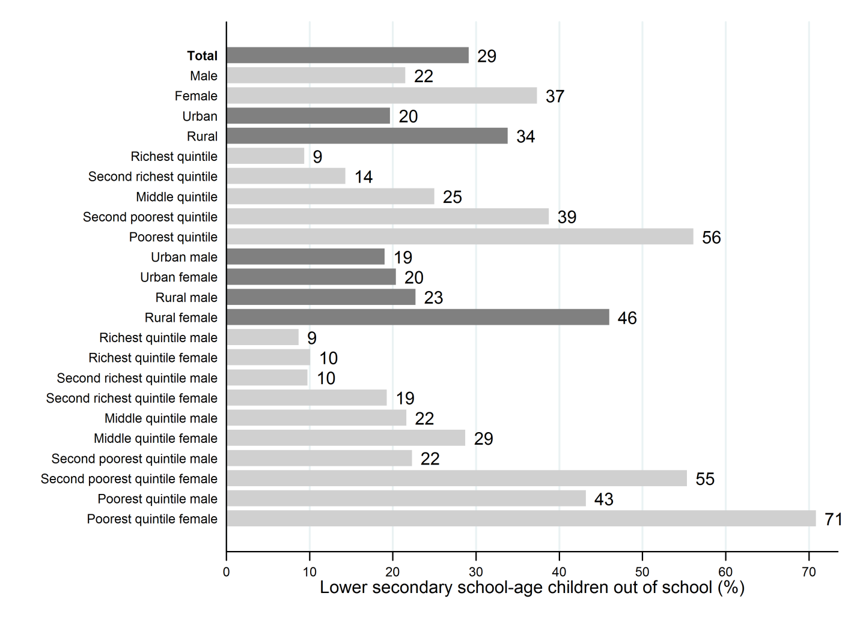
Out-of-school children of lower secondary school age, Pakistan, 2006-07
Going beyond performance and focusing on equity:
Differences across groups in out of school
Source: UIS calculations based on Pakistan DHS 2006-07

Slide 6
Out-of-school children from poor households are more likely to never attend school
Large differences across countries in equity
Nigeria
73
Yemen
45
Ghana
33
Timor-Leste
29
Kenya
23
Liberia
23
DR Congo
15
Cambodia
3
Colombia
1
Brazil
1
Zambia
-2
Kyrgyzstan
-12
Bolivia
-21
-20
0
20
40
60
80
Difference "will never attend" poorest-richest (%)
Source: Household survey data, 2006-2010. Data for children of primary school age.

Slide 7
Framing questions for today
Key contribution for Strand C is measurement for inclusion
How can we add meaning to access?
Can we provide a more complete picture on knowledge and skills for the PISA cohort?
What do we need to answer the questions:
Who is excluded? And why?
What do they know and can do? And how did they get there?

